Slide 1
Fossil Energy Opportunities for West Virginia
Dr. Tom S. Witt
Professor of Economics, Emeritus
West Virginia University

Slide 2
West Virginia Energy
Opportunities Project
Mandated under West Virginia code §5B-2F, the West Virginia Energy Policy and Development Act
Joint project with WVU-BBER and Marshall-CBER
Reports contain
  Overview of resource
  Short term development goals and action items
Notes:
Act calls for “… developing energy policies emphasizing the increased efficiency of energy use, the increased development and production of new and existing domestic energy sources, the increased awareness of energy use on the environment and the economy, dependable, efficient and economical statewide energy systems capable of supporting the needs of the state, increased energy self-sufficiency where the ratio of indigenous to imported energy use is increased, reduce the ratio energy consumption to economic activity and maintain low-cost energy. The energy policies and development plans shall also provide direction for the private sector.”
Each opportunity discussion will include the following:
Overview of the resource availably with a brief discussion of environmental impacts and technology requirements for development
Potential displacement (BTU equivalent) of imported oil where possible
Short term (less than 5 year) development goals and achievable action items
Achievable action items will be developed in collaboration with the Division of Energy.

Slide 3
West Virginia is a Major Energy Exporter Tbtu 2010
Total Energy Production 3,674
  Coal 3,346 .1 Coal
  Natural Gas 283.0
  Crude Oil 8.9
Total Energy Consumption 739
Difference -2,935
Wyoming Only Higher State -9,998
  Source: EIA, State Energy Data 2010

Slide 4
Report Outline
Introduction and Overview
Economic and Energy Outlook
Coal
Natural Gas
Nuclear
Electric Power
Hydrogen Fuels
Short-Term Development Goals 2013-2017

Slide 5
Economic and Energy Outlook
2013-2017
U.S. and W.Va. economic outlook
  Slower growth with W.Va. lagging behind U.S.
  Uncertainty re Europe and Asian slowdowns
Energy outlook based upon EIA AEO2012
  Significant growth in shale natural gas production
  By 2016 LNG exports
  Coal primary fuel used for electricity generation with Appalachian share declining
  Increased efficiency standards
  Declining role for energy imports
Notes:
Turning now to coal.

Slide 6
Notes:
The constant decline in state production of coal during this period was likely related to a number of factors, including the Great Recession and the lost production due to the Upper Big Branch mine explosion. In addition, the decrease in production is related to rising costs due to increasingly challenging geologic conditions and new safety regulations, a shortage of skilled workers, and increased scrutiny of surface mining permits. Rising world demand for coal likely softened the blow of these factors.

Slide 9
W. Va. Coal Industry in Serious Trouble
Patriot Coal bankrupt
Numerous other producers have announced mine closing and layoffs
Workforce W.Va. June employment indicates mining and logging employment decline to 31,100 from year ago rate of 33,200.
Coal stockpiles at electric generators are above normal with lower capacity utilization
Notes:
West Virginia Coal Economy 2008 production of approximately 158 million short tons of coal.
• employment of 20,454 individuals. • payment of $ 1.5 billion in wages.
• payment of $676.2 million in taxes to the state in the form of property, severance, worker’s compensation, corporate net income, special reclamation, sales and use, coal resource transportation road fund, and personal income taxes.
Electric utility, transportation and various impacts lead to totals:
jobs created was over 63,000.
• Total business volume generated was $25.53billion.
• Total employee compensation was nearly $3.6 billion.
• Total value added was $7.6 billion
Besides the economic impacts of the coal operators, the coal

Slide 10
BBER Consensus Coal Forecasts
Contract with W.Va. DEP for production and price forecasts
Three sources of forecasts used in developing consensus forecast
  Energy Information Administration
  Energy Ventures Analysis, Inc.
  WVU BBER

Slide 11
Source: BBER, Consensus Coal Forecast, 2012.
Notes:
The consensus coal forecast calls for production in West Virginia to fall from 134.6 million tons in 2011 to 130.5 million tons in 2012. This reflects the weak start to the year, as well as medium and long-run factors contributing to lower production levels. The consensus forecast then calls for state coal production to decline rapidly through 2020. Indeed, production is forecast to fall to 96.0 million tons by 2020, a decline of 28.7 percent during the nine year period. Thereafter, coal production stabilizes and eventually rises to 99.2 million tons by 2030, as natural gas prices gradually increase.

Slide 12
Future Opportunities for Coal Use
Electric generation-will cover later
Waste coal and gob-used in circulating fluidized power plants
Coal to liquids-TransGas in Mingo County
Key observations
  Coal will continue to be major contributor but will be rationalized
  Met coal exports will continue but challenges to southern thermal coal abound.
  Long term financing major challenge
  Environmental challenges vs. market reality
Notes:
The future prospects for additional power projects using waste coal and gob is problematic given the capital cost of these plants and their ability to compete in both capacity and power markets.
Coalbed methane-Within West Virginia CBM wells are concentrated in Monongalia, Marion, Wetzel, Marshall, McDowell, Logan, Wyoming, Raleigh, and Boone counties. West Virginia CBM production was 28 billion cubic feet in 2008 and 31 billion cubic feet in 2009.
Coal to liquids-TransGas-convert coal into 18,000 barrels per day of premium grade gasoline.

Slide 13
Natural Gas- Poised for Growth?
Horizontal fracking has results in significant supplies of natural gas being marketed today
W.Va.’s focus has been on the development of the Marcellus Shale formation and downstream value added opportunities
Current market prices are affecting production and development
Need for additional infrastructure for marketing and downstream value added opportunities
Notes:
The Economic Impact of the Natural Gas Industry and the Marcellus Shale Development in West Virginia in 2009
In 2009 the oil and natural gas industry in West Virginia employed 9,869 individuals and paid over $551.9 million in wages. The economic activities of the industry in 2009 generated a business volume impact of over $12 billion in the state’s economy and created approximately 24,400 jobs. The economic impact of the Marcellus Shale development in the state in 2009 was calculated to be $2.35 billion of business volume and accounted for the generation of 7,600 jobs
Study also project economic impacts associated with 0, 10 and 20 percent increases in permitting.

Slide 14
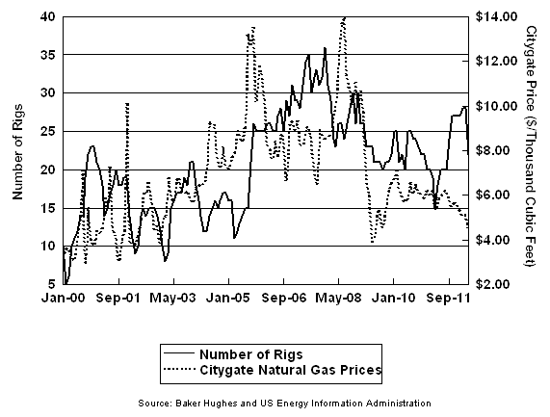
Number of Rigs and Citygate Natural Gas Prices in W.Va. 200-2012
Notes:
There have been 157 applications for horizontal wells, year to date. So that is on pace for about 300.2011 – about 520. 2010 – about 420.

Slide 15
Natural Gas Opportunities
Natural gas as a transportation fuel
LNG for export
NGL production and downstream use
  W.Va. Marcellus to Manufacturing Task Force-2011
  Growing importance of midstream and pipeline network and storage
Significant capital investments are underway and more will come
Notes:
Analyze the feasibility of converting ethane to ethylene in West Virginia including available sites for ethane crackers.
1. Locate and analyze existing infrastructure including pipelines and storage facilities.
2. Identify potential companies specializing in the construction and operation of ethane crackers.
3. Identify companies with capital and other resources to invest in the natural gas, ethane conversion and revitalization of the state’s chemical and manufacturing industries.
4. Formulate a comprehensive Marcellus to Manufacturing Action Plan.
5. One outcome was the passage of HB 4086 during the 2012 Session that was signed into law by Governor Tomblin. This bill provided a reduction in personal property taxes for a company that invests at lead $2 billion in building an ethane cracker in West Virginia.
6. Transition to Electricity Generation but briefly mention nuclear and hydrogen

Slide 17
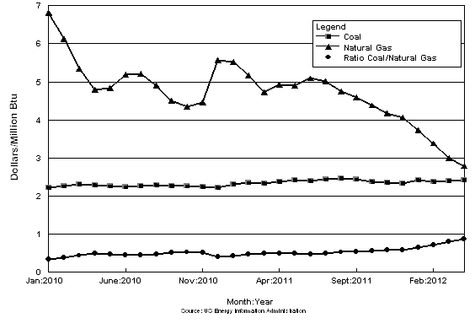
Average Cost of Coal and Natural Gas for Electricity Generation

Slide 19
Notes:
Generation from natural gas-fired plants is virtually equal to generation from coal-fired plants, with each fuel providing 32% of total generation. In April 2012, preliminary data show net electric generation from natural gas was 95.9 million MWH with coal at at 96.0 MWH.
AEP eastern coal plants rate at 47 % of capacity in 2012Q1 compared to 61% in 2011Q1.
Also in April, natural gas prices as delivered to power plants were at a ten-year low.
EIA 10% increase in delivered fuel price of coal to natural gas leads to a 1.4% in use of natural gas relative to coal.

Slide 20
EPA Regulations Playing
Key Role in Coals Future
Dec. 2010 EPA settles lawsuit by committing to develop standards for both new and existing power plants and refineries
March 27, 2012 EPA proposes first numerical limit on GHS emissions from power plants
Standard of 1,000 pounds of CO₂ per megawatt-hour for new plants greater than 25MW
Peaking units, typically much smaller, exempt
New coal plants effectively banned
Room for new coal plants with CSS but will not be built unless Congress subsidizes
Mercury and Air Toxics Standards (MATS) Rule also confronting utilities.
Notes:
MATS-Limits emissions of mercury, arsenic and other purported toxic substances from new and existing power plants.
These rules could lead to significant reductions in coal-fired generation and may lead to ireduced reliability issues.

Slide 21
AEP and First Energy Announce
Unit Retirements in W.Va.
AEP to retire 4,600 MW coal-fueled power generation system-wide by 2015
  Philip Sporn
  Kammer
  Kanawha River
  Big Sandy (KY) conversion to NG
First Energy closures prior to September 1, 2012
  Willow Island
  Albright
  Rivesville
WVPSC reviewing FE decision to close Willow Island
Notes:
Big Sandy conversion to natural gas could result in one millions less of WV coal delivered and burned at the plant.
AEP will retire more than 4,600 MW of coal-fueled generation.

Slide 22
Projected Net Summer Capacity by Fuel Type 2009-2035

Slide 23
PJM and Electric Generating
Plant Dispatch
Regional transmission organization coordinating movement of wholesale electricity in all or parts of 13 states and DC
Operates a competitive wholesale electricity market
Establishes systems and rules to insure markets operate fairly and efficiently
Balances the needs of suppliers, wholesale customers and other market participants

Slide 24
PJM Recent Decisions
Annual reliability pricing model procures resources to meet power supply needs
Latest auction results for June 1, 2015-May 31, 2016 reported:
  New generation of 4,900 MW with most natural-gas fired with additional amounts of solar and wind
  Energy efficiency and demand response also included
  Capacity imported from west of PJM increased as well
Capacity will offset the ‘unprecedented amount of electric generation retiring within the next three years” (2012-2015)
Notes:
Transmission monitoring on real time basis
Long-term transmission planning and approvals
As of April 2012 generation owners in PJM announced plans to retire 14,000 MW of generation through end of 2015
PJM approval in April of $2 billion in electric transmission upgrades to insure reliability

Slide 25
Short-Term Development Goals
Continue to monitor and publicize energy data and report on the implications for the continued growth and development of the state’s energy sector.
Advocate the economic importance of West Virginia's energy resources at the national, regional and state levels.
Recognize that the current domestic and international economic climate may result in significant short-term demand/supply responses with the potential for major impacts on the state’s fossil fuel resources.
Convene meetings with industry, academic, federal agencies and public officials to assess current fossil energy production and value added opportunities.
Establish strong working relationships and support for NETL.
Expand West Virginia’s funding for basic fossil fuel research programs at West Virginia’s research universities.

Slide 26
Short-Term Development Goals
Coal
  Partner with industry to continue development of polygeneration plant(s) converting coal to liquids.
  Continue to monitor thermal and metallurgical coal national and international markets to identify opportunities for W. Va. producers

Slide 27
Short-Term Development Goals
Natural gas
  Need sufficient midstream natural gas gathering and processing facilities.
  Intra-and interstate pipelines associated with the transport of natural gas and associated liquids.
  Attract one or more ethane crackers and associated downstream petrochemical manufacturing facilities.
  Work with the Governor’s Natural Gas Vehicle Task Force, state and local agencies, private industry and transportation agencies to implement the recommendations of the taskforce.
  Examine the feasibility of converting biodiesel used in county school system fleets to compressed natural gas and/or propane.

Slide 28
Short-Term Development Goals
Electric Generation
  Advocate the importance of retaining the fossil fuel generation to the continuation of affordable electricity to residential, commercial and industrial users.
  Work with the various development agencies to insure industrial users have access to affordable uninterruptible electricity supplies.
  Partner with industry to assess the commercial feasibility of carbon capture and storage technology coupled with enhanced oil recovery.
  Continue to support development and adoption of Oxy-Combustion technology to reduce emissions and facilitate carbon capture.
  Continue to monitor federal regulations regarding CO₂ and mercury emissions.

Slide 29
Contact Information
Dr. Tom S. Witt
Professor of Economics, Emeritus
College of Business and Economics
West Virginia University
C 304.376.9827
tomswitt@gmail.com

