Slide 1
WV Energy Plan Public Hearing
Eric Bowen, PhD
West Virginia Division of Energy
September 2017

Slide 2
WV Energy Plan Public Hearing
Eric Bowen, Ph.D.
West Virginia Division of Energy
September 2017
Bureau of Business & Economic Research
College of Business & Economics
West Virginia University
www.be.wvu.edu/bber
Copyright ©2017 by WVU Research Corporation

Slide 3
Coal

Slide 4
Coal Production, US and WV (Annual)
Notes:
Production fell from about 160M tons in 2008 to less than 80M in 2016.
2016 was a particularly bad year. It’s bounced back a bit so far in 2017
Key Drivers (DOE Report):
Natural Gas boom – competitive fuel
Environmental regulatory climate – particularly MATS
Exports and international demand

Slide 5
Key Drivers of Demand Decline
Natural Gas Boom
Environmental Regulatory Climate
International Demand
Notes:
The most significant drivers of demand decline are
Recent report to the Perry Department of Energy confirmed gas was the largest driver

Slide 6
Coal Production by WV Region (Quarterly)
Notes:
Production declines almost entirely in southern WV
Production in southern WV was three times that of the north
Declines have led to substantial employment losses, especially in the south
Employment fell by 13T jobs between the end of 2011 and 2016 – 52% decline

Slide 7
Coal Mine Worker Productivity
Notes:
Northern WV had a shift from surface to underground mining
Southern was a loss across the board – fallen by about half
Has to do with best coal already being mined out

Slide 8
Figure 8: Coal Production Forecast
Millions of short tons
Northern WV
Notes:
Forecasting more of the same

Slide 9
Figure 9: Coal Employment Forecast
Notes:
Done before the recent up-tick in coal production
Forecasting that employment will remain at its lower level for the next five years
This is a challenge that the state will have to deal with for the foreseeable future

Slide 10
Natural Gas

Slide 11
Figure 11: Natural Gas Marketed Production
Notes:
This is certainly a different story than coal

Slide 12
Figure 12: Natural Gas Employment Forecast
Notes:
Gas employment has declined a bit as new drilling has fallen
We forecast that employment will rise again over the next five years as we return to new drilling in the state

Slide 13
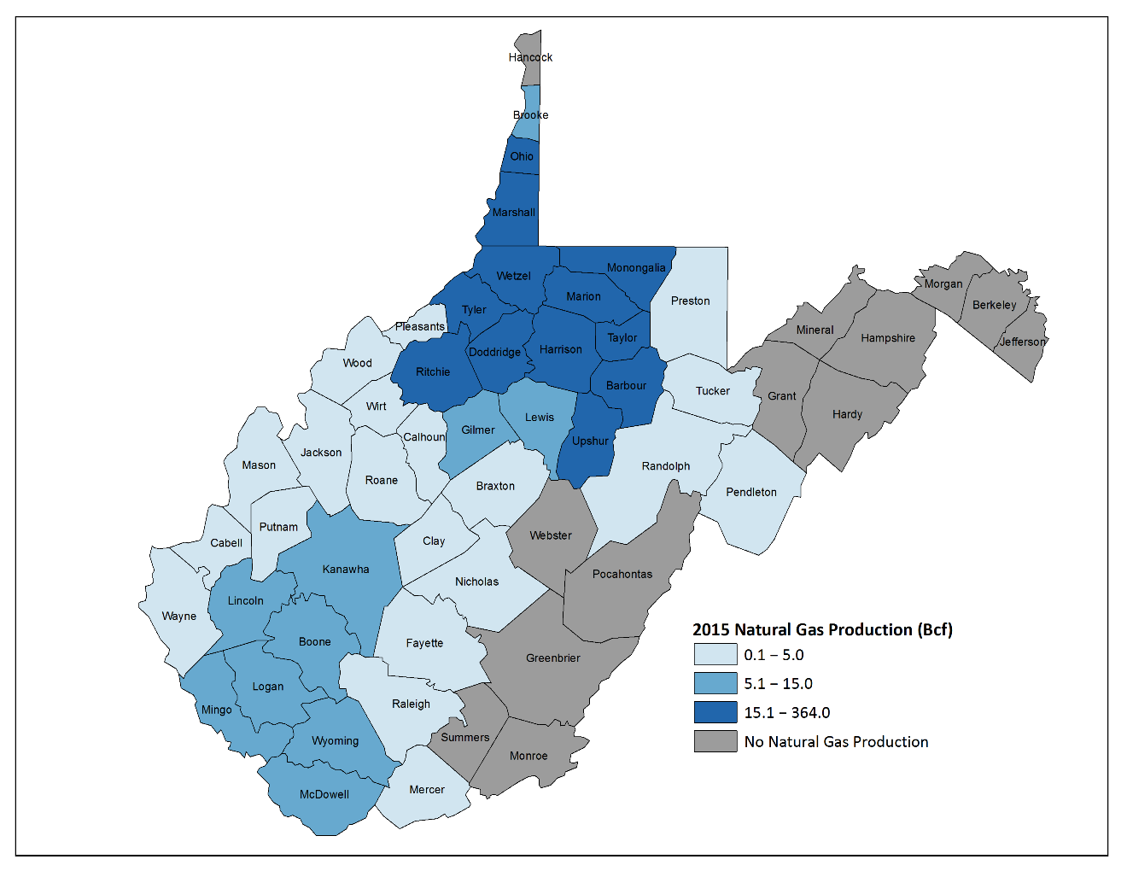
Figure 13: Natural Gas Production by County (2015)
Notes:
Most of the production and economic gains have gone to the northern part of the state
Ritchie, Doddridge counties were mostly rural with little economic activity
Large increases around the Marshall County and Wheeling areas

Slide 14
Figure 14: Natural Gas State-to-State Pipeline Transmission Capacity, WV (Annual)
Notes:
One bottleneck for gas produced in WV has been pipeline capacity
Currently there are another 18,650 Bcf per day capacity planned
More than double outgoing pipeline capacity
Should allow local prices to equalize with higher prices in the Northeast US

Slide 15
Electricity Production

Slide 16
Figure 16: Electricity Generation by Fuel Type, US (Quarterly)
Notes:
Once again national trends are affecting WV
Dramatic shift in the fuels used in electricity production

Slide 17
Figure 17: Coal-Fired Power Plant Capacity Factors
Notes:
Capacity factor is a measure of utilization of the power plant
Fallen from about 68% in 2008 to about 52% in 2015

Slide 18
Figure 18: Coal-Fired Power Plant Retirements
Notes:
Decline in demand for electricity from coal-fired power plants has caused retirements to spike
About 37 GW were retired nationwide between 2012 and 2015
About 2.4 GW were retired in WV
About 14 percent of the state’s total capacity
Increase in Natural Gas capacity
About 1,900 MW of gas capacity have been proposed
Replace about ¾ of retired coal capacity

Slide 19
Figure 19: Average Electricity Price by Consumer Category
Notes:
Also concerning, average electricity rate have gone up over the past decade
Industrial rates are particularly concerning as our low rates were an attractive feature of the state for new businesses to come in
Three potential reasons:
Fuel price increases
Emission control technologies
Lower utilitzation may have caused utilities to recover revenues from stranded assets

Slide 20
Public Policy

Slide 21
Policy Options
Worker Retraining Programs
Severance Tax Modifications
Research Electricity Rates
Utility Restructuring
Redevelopment Incentives for Retired Coal-Fired Power Plant and Mine Sites
Notes:
I will say up front that we are not advocating any particular public policy
We do have some areas we think the state could examine in the coming years

Slide 22
Questions

