Slide 1
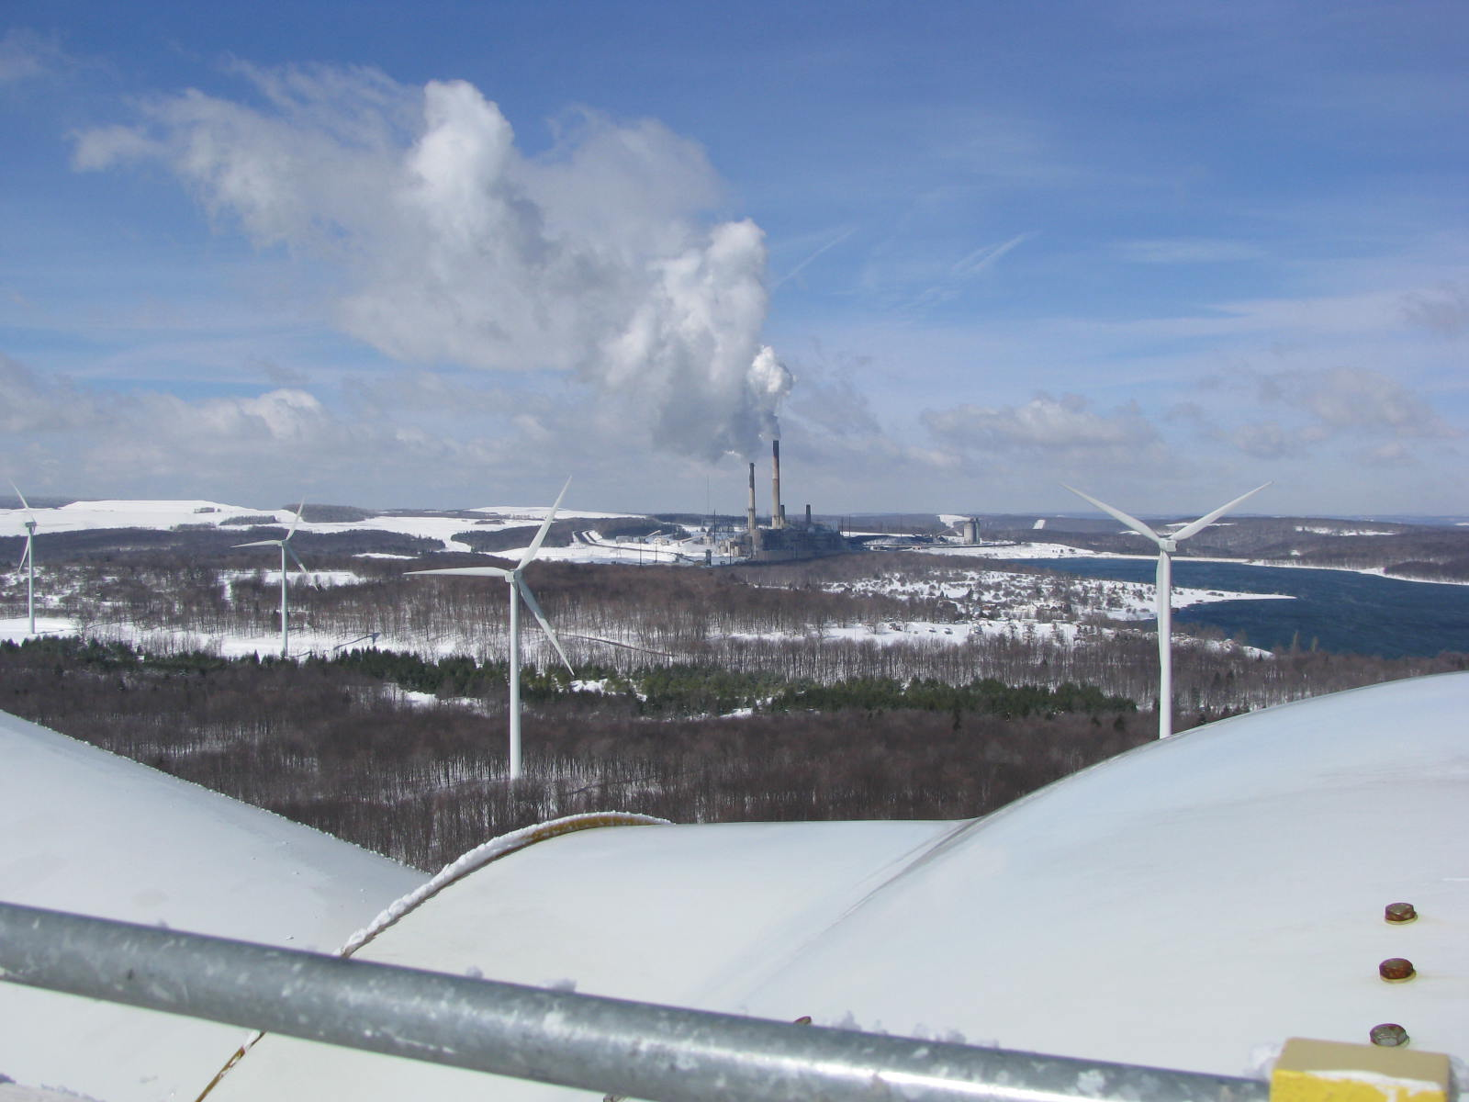

Energy Opportunities: Solar, Wind, Energy Efficiency
September 2012

Slide 2
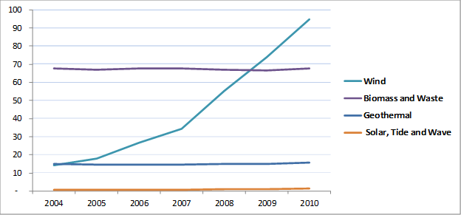
U.S. Electricity Generation by Non-Hydro Renewable Resources (billion kWh)

Slide 3
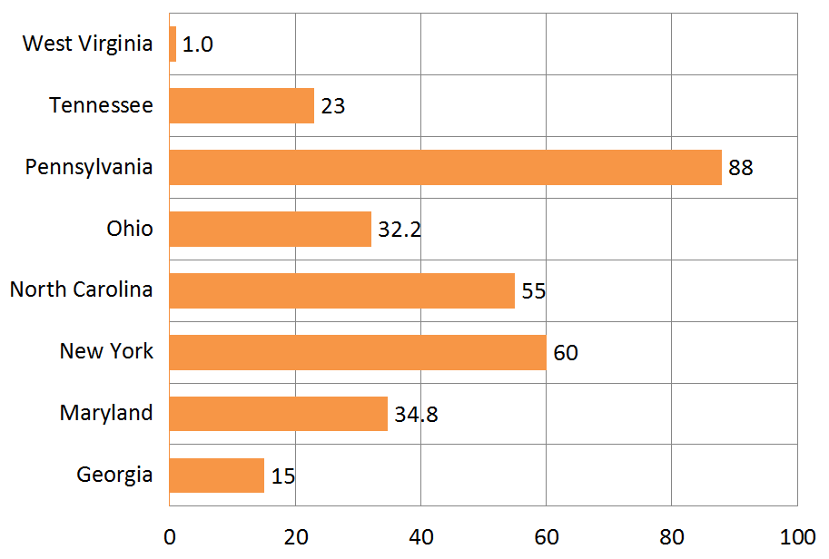
Approximate Installed
Solar Capacity (MW)

Slide 4
Average Annual Solar Insolation,
Selected Cities
Area | kWh/m² /Day |  | Area | kWh/m² /day
Daggett, CA | 6.51 |  | Philadelphia, PA | 4.75
Las Vegas, NV | 6.31 |  | Charleston, WV | 4.55
Flagstaff, AZ | 5.91 |  | Cleveland, OH | 4.31
Austin, TX | 5.24 |  | Boston, MA | 4.23
Atlanta, GA | 5.03 |  | Seattle, WA | 3.67
SOURCE: PV Watts (2012).
WV’s insolation is ranked the 8th lowest out of 50 states.

Slide 5
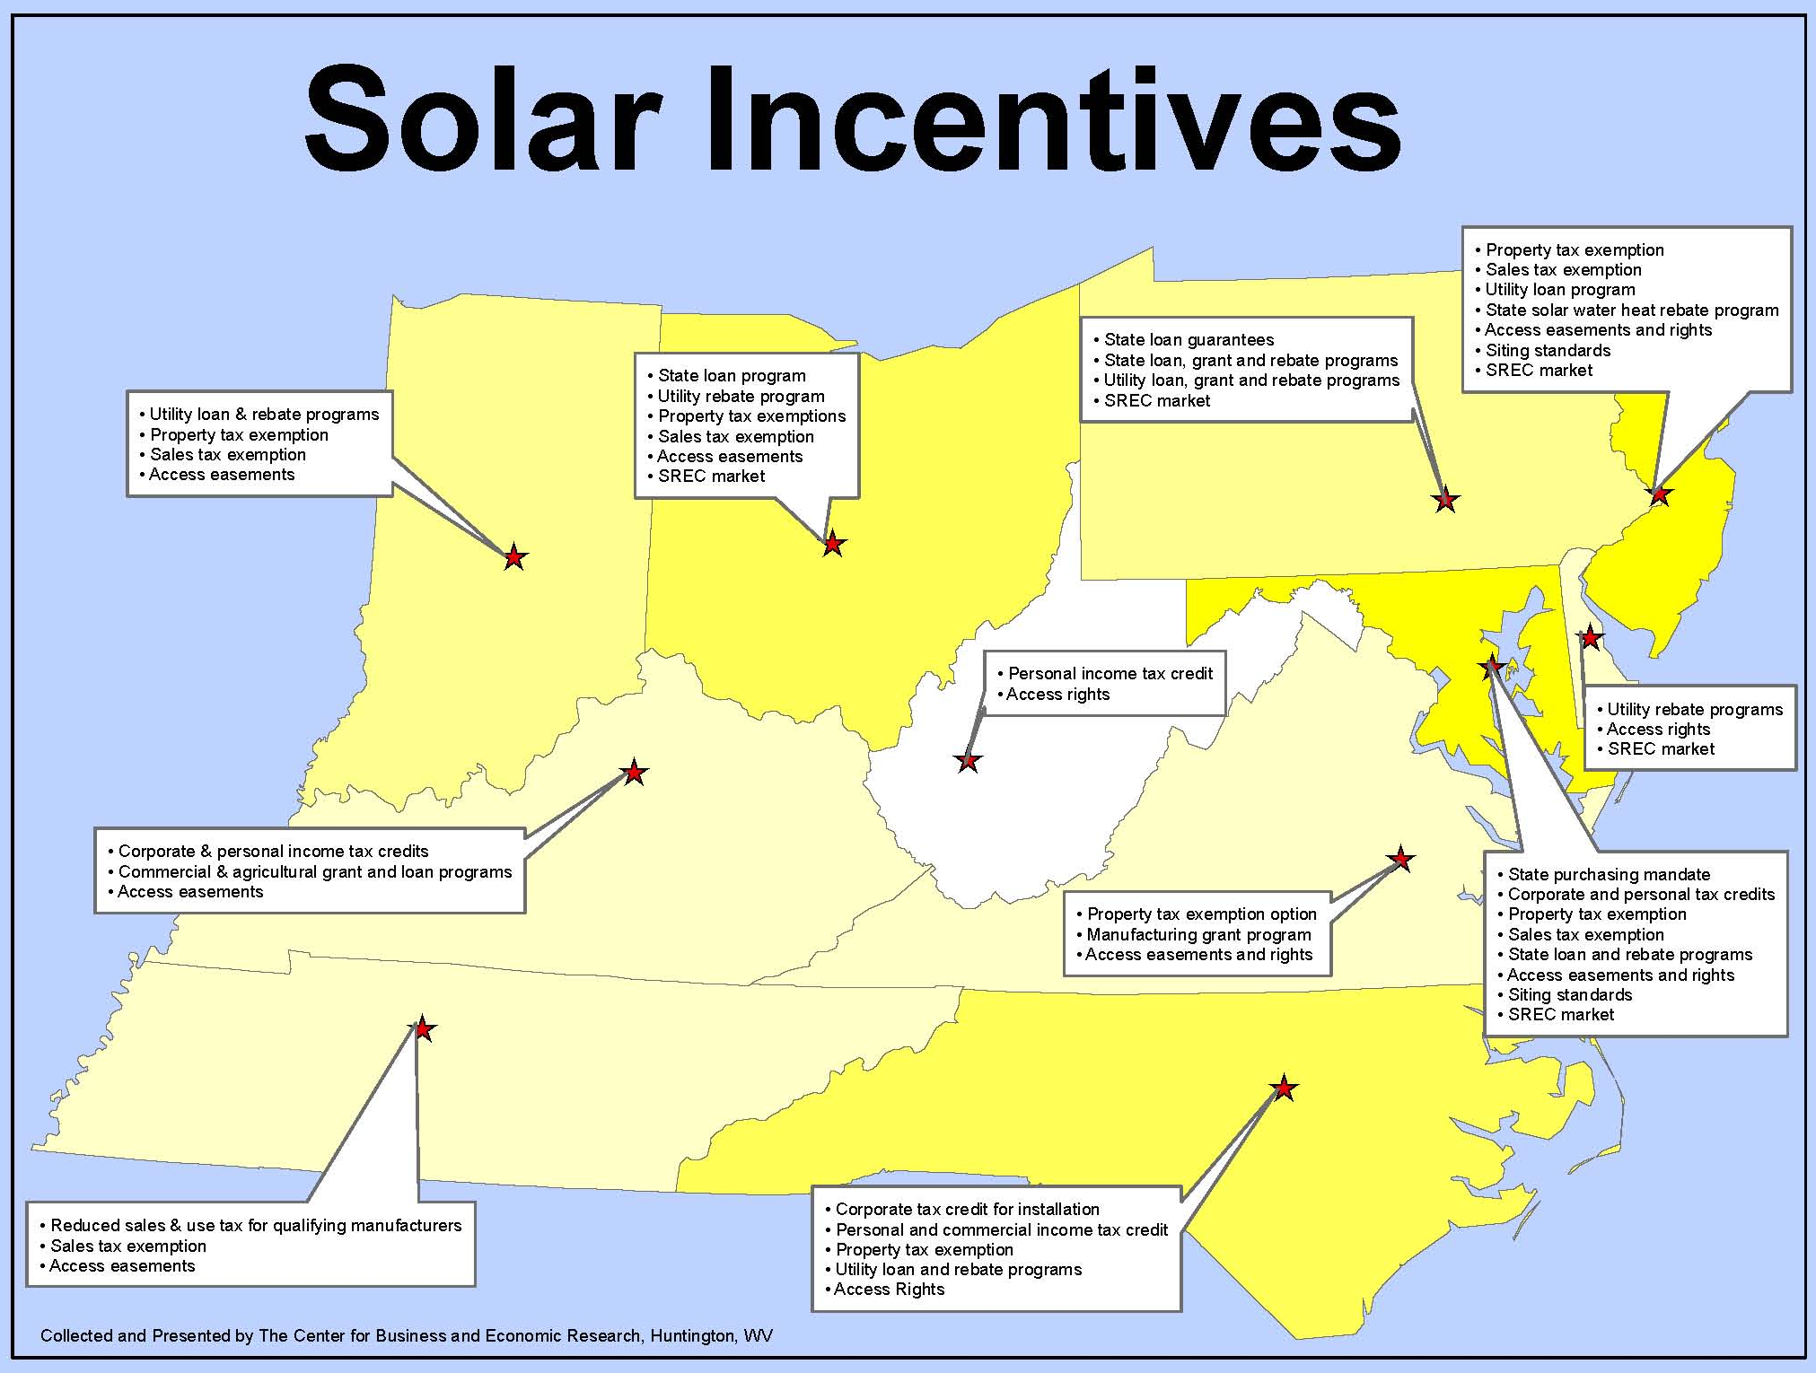

Slide 6
Solar Conclusions
Solar energy is a moderate resource in WV
Solar does not contribute as much economically due to little manufacturing and low operating costs.
Primary economic benefits come from applicable taxes, the removal of which are common incentives.
Funding solar through utility rates obscures the real price of avoided electricity purchases.
SREC markets assign the role of market maker to State Legislatures.
Unresolved grid integration issues reduce the ability to offset fossil resources.
Beyond 5 years, grid integration solutions will be more widespread allowing more benefit.

Slide 7
Solar Policy Recommendations
Maintain current policies. The current policy is likely to induce some interested WV residents to adopt solar PV technology, but not at very high levels.
Monitor the results of research being conducted on the options to efficiently integrate wind and solar resources into the grid.
  Applicable State Organizations: Division of Energy, Public Service Commission.

Slide 8
Installed Wind Capacity and Generation in Regional States, as of 2011
State | Installed Capacity | State Rank in 2011 | % of In-State MWh in 2010 | % of In-State MWh in 2011
Delaware | 2 MW | 37th | 0.05% | 0.04%*
Illinois | 2.7 GW | 4th | 2.21% | 3.15%
Indiana | 1.3 GW | 13th | 2.34% | 2.72%
Maryland | 120 MW | 28th | 0.00% | 0.76%
New Jersey | 7.5 MW | 36th | 0.02% | 0.02%
New York | 1.4 GW | 12th | 1.90% | 2.06%
Ohio | 112 MW | 29th | 0.01% | 0.13%
Pennsylvania | 789 MW | 15th | 0.81% | 0.86%
West Virginia | 610 MW | 20th | 1.16% | 1.39%
Sources: (Wind Powering America 2012), (AWEA 2012) and (EIA 2012).
* Data not published. Percentage is based on the same output as in 2010.

Slide 9
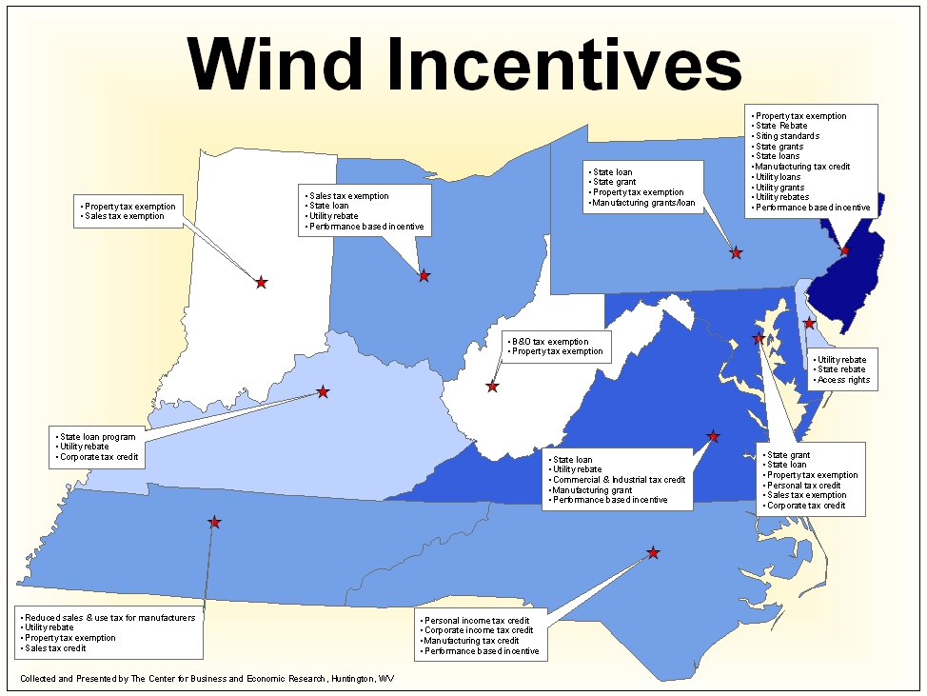

Slide 10
Wind Conclusions
The quantity of wind estimated to be “developable” on private land may be less than what is developed or under consideration.
Lease payments and property taxes are the biggest economic impact of wind. Turbine maintenance services also. Manufacturing is minimal.
Siting of wind facilities is very difficult, but almost the same as for other power plants.
Unresolved efficiency issues related to grid integration of wind energy need to be understood more in terms of accomplishing policy objectives.
The extension of the federal PTC will determine future development efforts.

Slide 11
Wind Policy Recommendations
Maintain current policies. The two existing State tax incentives are a balanced acknowledgement of public and private interests.
Monitor the results of research being conducted on the options to efficiently integrate wind and solar resources into the grid. Applicable State Organizations: Division of Energy, Public Service Commission.

Slide 12
Energy Efficiency Overview
Where is the State in efficiency efforts?
  First Energy - $2 million program
  Appalachian Power - $6 million program
  Adoption of recent industry standards for construction of State buildings
  Building code training by WVDOE
  Federal programs – Industries of the Future, Industrial Assessment Centers, low-income weatherization assistance

Slide 13
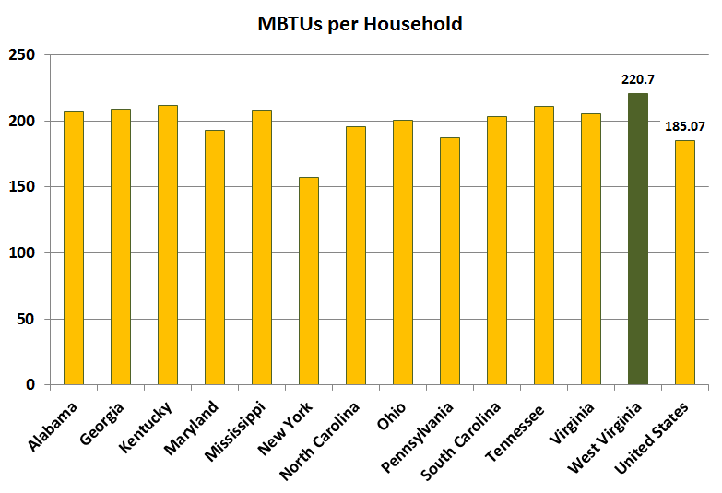
Household Energy Consumption, Appalachian States
Sources: U.S. EIA, U.S. Census Bureau’s American Community Survey 2009 and 2010 Census

Slide 14
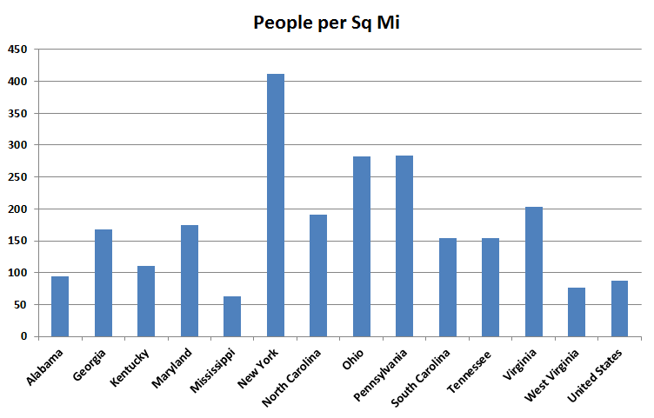
Population Density,
Appalachian States
Sources: U.S. EIA, U.S. Census Bureau’s American Community Survey 2009 and 2010 Census

Slide 15
Benefits of Energy Efficiency
More efficient use of resources (getting more with less)
Can reduce impacts of increasing electricity rates
Can contribute to a decrease in peak power demand due to the decrease in overall demand
Can put off the need to build more power plants and T&D lines (and associated costs)
Local job creation

Slide 16
EE Policy Recommendations
State-Related:
Statewide adoption of the 2009 IECC and 2007 ASHRAE standards
Keep the State no further than one series of codes behind the most recent version
Appointment of an Energy Efficiency Ad-hoc position to the State Fire Commission
Conduct a study to evaluate the feasibility of making the energy code portion of the State Building Code enforceable statewide.
Continue support of WVDOE EE-related programs

Slide 17
EE Policy Recommendations
Utility-Related:
Establish an Energy Efficiency Resource Standard with targeted goals for producing energy savings via EE programs.
Implement decoupling or a similar mechanism to allow for reasonable recovery of utilities lost revenues resulting from State-mandated EE programs.
Establish a stakeholder working group to provide guidance on EE program elements such as program evaluation, level of resource standards, potential program expansion and decoupling provisions.

Slide 18
The End

