Slide 1
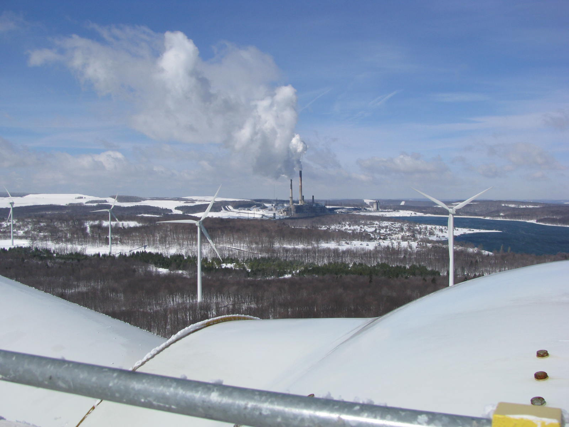

Energy Opportunities: Renewables
September 5-7, 2012

Slide 2
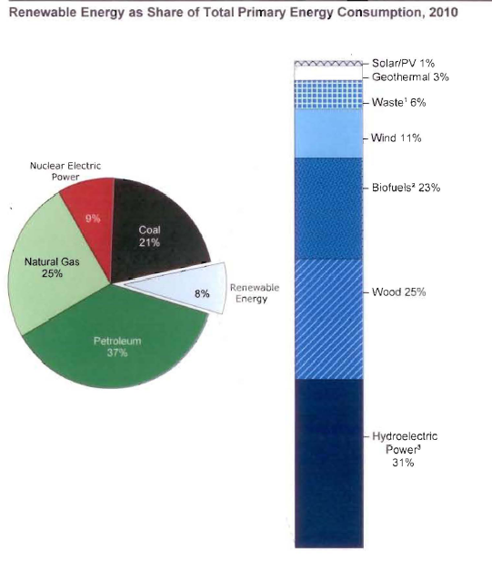
Figure 1: U.S. Renewable Energy as Share of Total Primary Energy Consumption, 2010

Slide 3
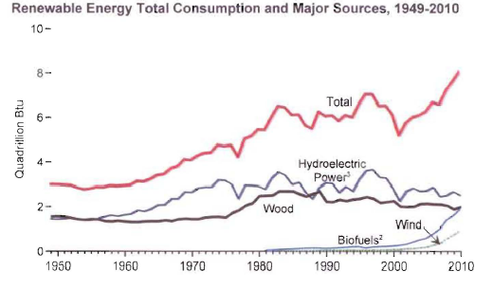
Figure 2: Renewable Energy Total Consumption and Major Sources, 1949 to 2010

Slide 4
Five Year Energy Plan
This report is concerned with West Virginia’s energy opportunities to be included in the next five year plan.
Beyond the next five years the fast changing energy market makes forecasting and planning difficult.
The focus is “what should the State do in the next five years to strengthen West Virginia's energy economy?”

Slide 5
Overall Conclusions
None of the renewable of alternative energy sources is likely to provide fuel or electricity at a lower cost than traditional sources
Transition from current to renewable fuels will require either state subsidies or higher utility rates or both

Slide 6
Overall Conclusions 2
There is a need to monitor potential transportation and transmission issues related to renewables
Environmental concerns regarding alternative and renewable fuels should be fully addressed.
The State’s Alternative & Renewable Portfolio Standard (ARPS) provides incentives for the use of renewable energy

Slide 7
Biomass: Conclusions
There is little likelihood that ethanol production from corn is going to happen
There is limited potential for development of biodiesel in WV
The use of woody biomass should be further investigated considering the extent of forestation in the state

Slide 8
Biomass Conclusions 2
Use of switchgrass and A donax as a biofuel requires more research, but both can be grown on marginal and reclaimed land
Population densities in WV do not appear sufficient to justify municipal Waste-to-Energy projects although they have been successful elsewhere.

Slide 9
Biomass Conclusions 3
Energy from Landfill Gas (LFG) merits little consideration as the needed infrastructure and physical characteristics do not make it feasible.
Chicken litter has more economical uses than as a fuel

Slide 10
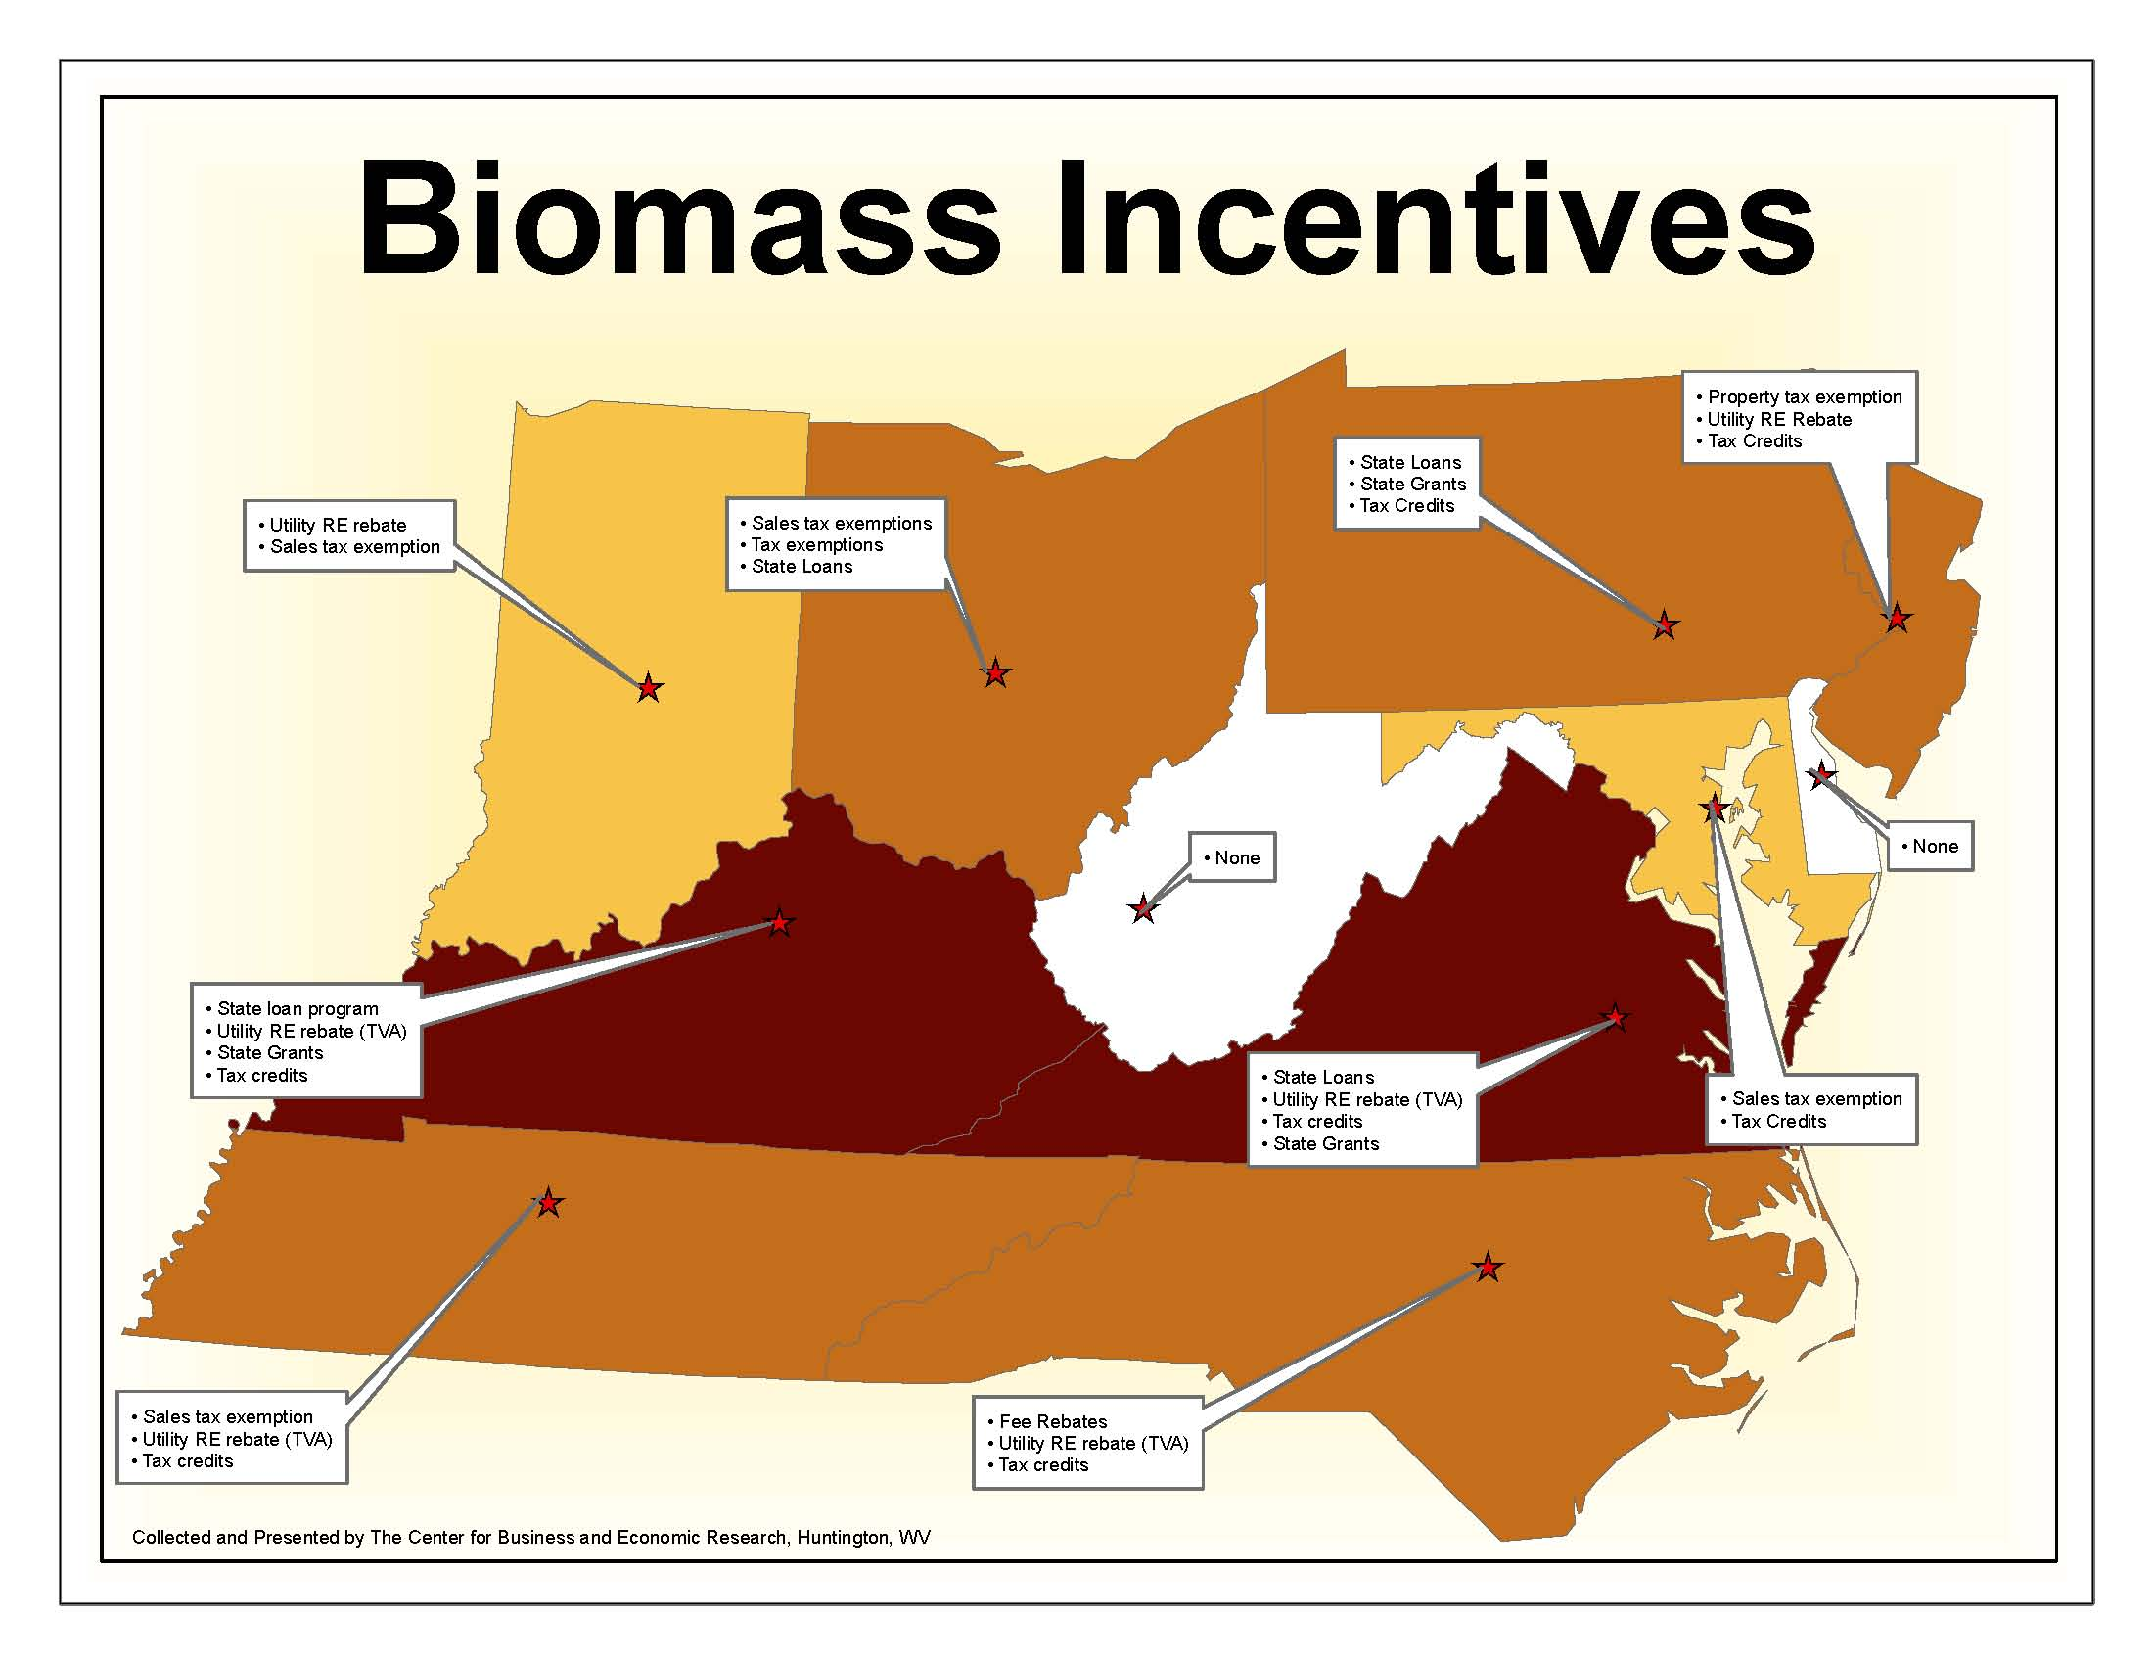

Slide 11
Other Conclusions
Due to the depth of the resource and the cost of recovery, geothermal is not now an economically feasible option for WV
Large and medium hydro has or is being developed. Small scale hydro would have only very limited application.

Slide 12
Recommendations
Efforts to promote corn ethanol blending into to gasoline should be resisted
The costs and benefits of the support for use of biodiesel in school buses should be investigated
The potential for use of wood biomass as a fuel should be pursued

Slide 13
Recommendations 2
The possibility of using small scale hydro at remote locations should be studied
Research on switch grass and A donax on reclaimed and marginal land should continue
Possibility of developing WTE projects on a regional basis should be considered

Slide 14
Recommendations 3
Developments regarding LFG should be monitored with the possibility of including more sites if feasible
The state should be up-to-date on EPA regulation of uses of chicken litter which may determine if it is feasible to use as a fuel

Slide 15
Thank You

