Slide 1
Biomass as a fuel and blending stock
Shawn T. Grushecky
Assistant Director
WVU Appalachian Hardwood Center
sgrushec@wvu.edu

Slide 2
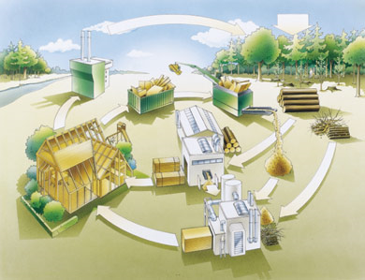
Why is wood biomass an important component of a WV energy portfolio?
Advantages of woody biomass:
Is available
Is renewable & sustainable
Minimal heavy metals and sulfur
Can reduce waste streams
Does not increase atmospheric levels of CO₂
Locally produced
Source:woodforgood.com

Slide 3
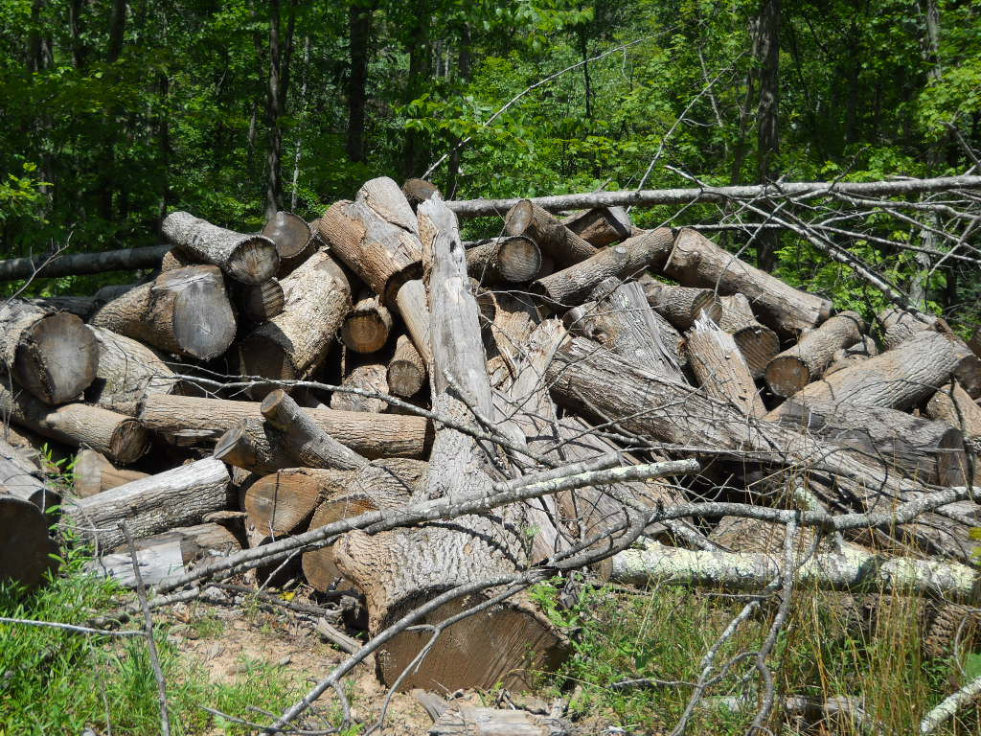
Biomass Production Potential
Logging residues: 1,528,800 tons
Log landings: 509,600 tons
Mill residues: 1,252,650 tons
Surface mine residues: 353,407 tons
Total: 3,644,457 tons per year

Slide 4
BIOENERGY RESEARCH TEAM AT WVU
>$19 million funding, 120 journal papers in 5 years
RA 1 - Sustainable Feedstock Development.
Breeding and genetic engineering for improved energy crops;
Harvesting and supply-chain related logistical systems;
Integrated preprocessing technologies.
RA 2 – Biofuels and Hybrid Bio-Fossil Product Development.
Novel bio-chemical separations to produce clean fractions;
Biofuel/biochemical products from biomass carbohydrates;
Hybrid system for lignin-biomass/coal blends for synthetic gas, electricity, and liquid fuels.
RA 3. Biofuels and Bioproduct Development Analysis.
Life cycle analysis and system modeling;
Fossil fuel displacement, sustainability and rural economic development;
Commercialization through relationships with industrial partners.

Slide 5
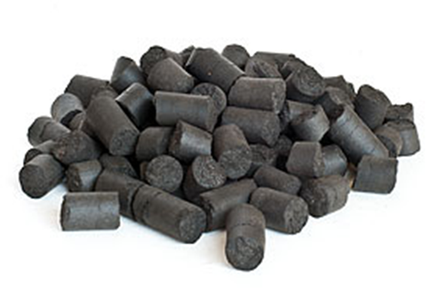
TORREFIED WOOD
Heating wood at low O₂ high temp condition (400-600 F)
20 % mass loss, 10 % energy loss
Final product hydrophobic
Co-fired directly with coal, raw material for liquids, steel production
WVU Samples ~ 9500-10,000 BTU/LB

Slide 6
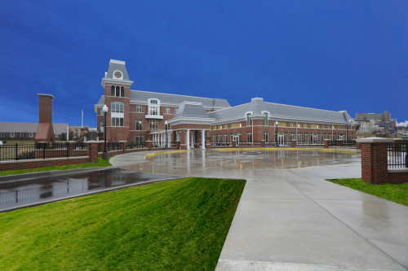
Coal/Biomass Conference – Sept 19th 2012
Topics
Coal/Biomass Opportunities
Bioenergy Research
Energy policy and environmental impacts
Business Perspective – torrefied wood
Economic and Technical Feasibility of CBTL
Clean Energy Research and Development with Coal
Carbon Capture Technology
More info - http://ahc.wvu.edu

